Slide 1
Friday’s Quiz
Review events of the following myths:
Enuma Elish
What is created in the myth, and how?
How does Marduk rise to power?
Descent of Inanna
Details of underworld
Significance of Inanna; traits
The Epic of Gilgamesh (Ch 1-5)
Duality between Gilgamesh and Enkidu
City v. Country
Significance of Dreams
Enkidu’s fate and its effect on Gilgamesh

Slide 2
The Quest for Self
“Every agent acts either by nature or by intelligence.” — St. Thomas Aquinas, “The End of Man” (13th c.)

Slide 3
Actions and Traits in Ch.3
In the epic, Gilgamesh and Enkidu become friends who represent different sides of themselves (duality).
Thinking back to the events of Ch. 3, recall the actions and traits of each character as they prepare to battle Humbaba, the protector of the Cedar Forest.
After Ch. 4, how are some characteristics swapped between characters?
Enkidu
Gilgamesh
Enkidu
Gilgamesh

Slide 4
Actions and Traits in Ch.3
Enkidu
Wild
Kind
Weakened
Afraid
Cries
Reluctant
Good judgment
Avoids danger
Instinctual
Mysterious
Compromising
Emotional
Gilgamesh
Brutal
Selfish
Beds women
Demands attention
Overbearing
Poor judgment
Knocks down walls
Wants glory
Stubborn
Violent

Slide 5
Answer in your groups:
Thinking very stereotypically, how do these two characteristics represent two sides of oneself? What do Gilgamesh’s traits and actions symbolize? Enkidu’s?
How might these characteristics represent the Sumerians’ views of city v. country? Which do you believe they valued more?

Slide 6
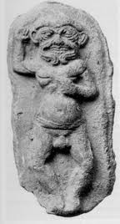
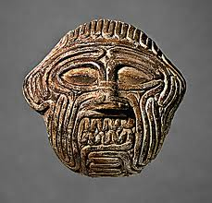
Humbaba
Gilgamesh insists on killing Humbaba, a monster who protects Cedar Forest
Humbaba represents evil, but we never see him doing anything evil to anyone.
To Sumerians/ Babylonians, Humbaba= ritual sacrifices gone wrong
Represents the fearful side of nature (feminine side)
The things we wish we could do without
Death
Natural Disasters
Dangerous animals

Slide 7
Humbaba
Think about Gilgamesh’s desire to kill Humbaba. What do you think about Gilgamesh’s behavior and his ability to give and take in his relationship with Enkidu?

