Slide 1
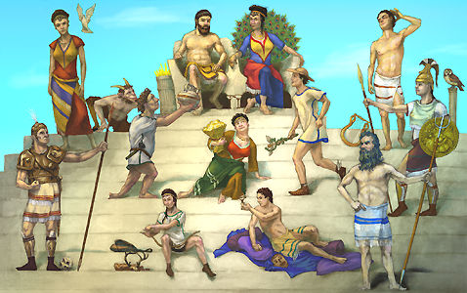
The Gods and Goddesses of Greek Mythology

Slide 2
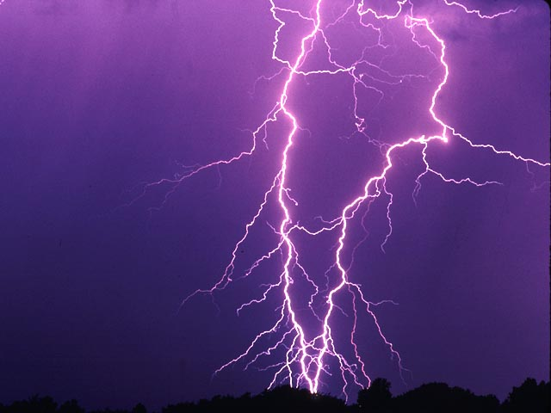
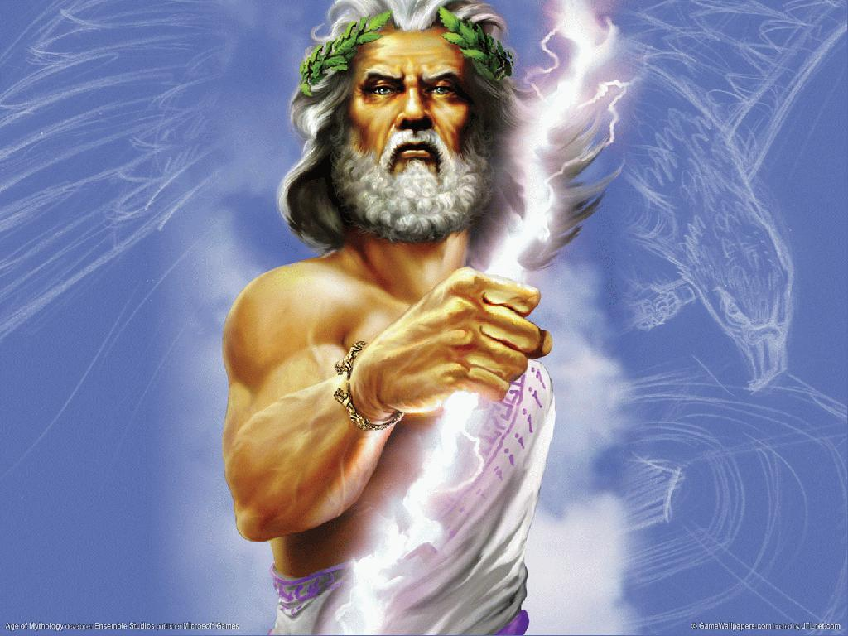
Zeus/Jupiter
God of the Heavens and King of the Gods.
Symbol: Lightening Bolt, Thunder, Eagle

Slide 3
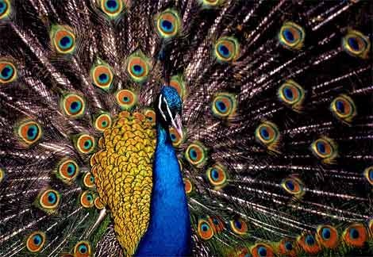
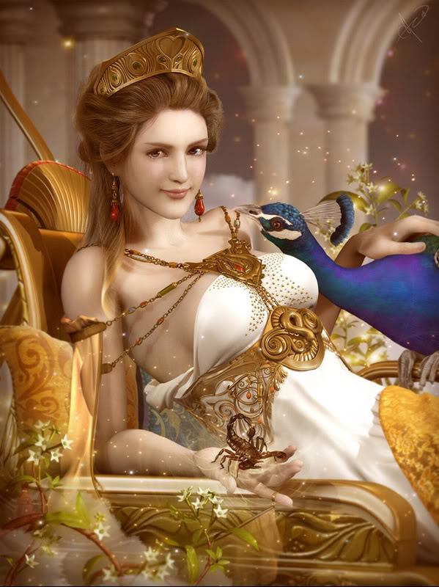
Hera/Juno
Goddess of Marriage and Family, Queen of the Gods
Wife of Zeus
Symbol: Peacock

Slide 4
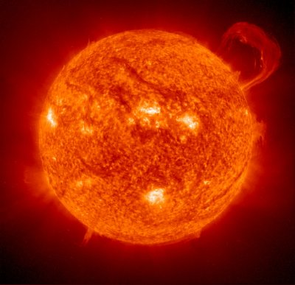
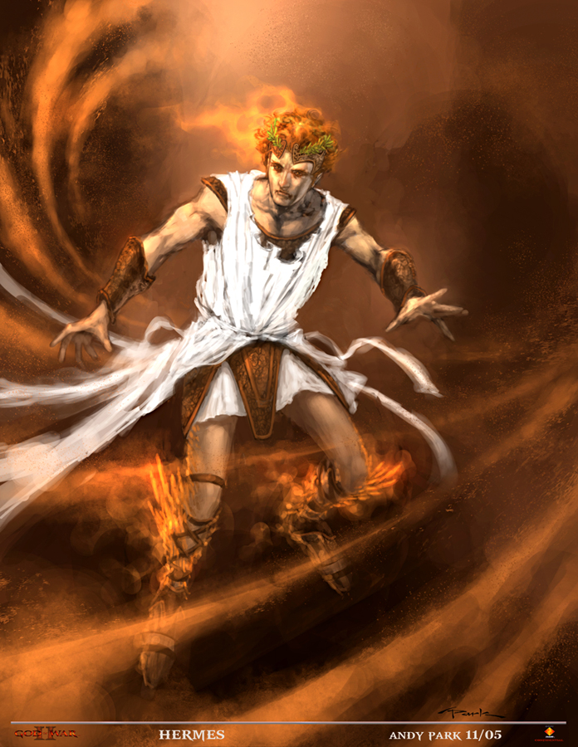
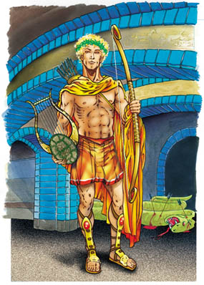
Apollo/Helios
God of the sun, healing, medicine, prophecy, enlightenment, & music
Symbols: Laurel, Bow, Lyre

Slide 5
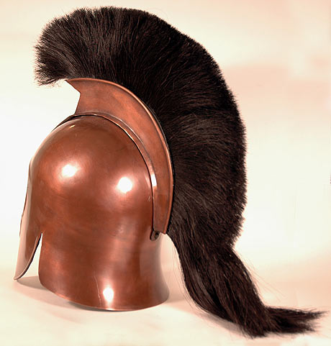
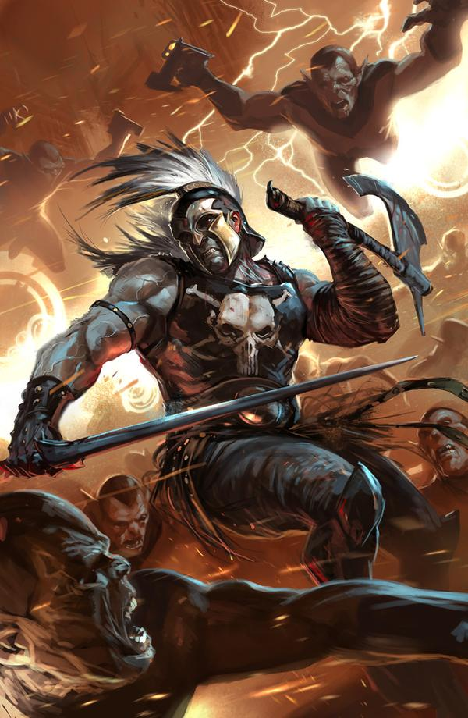
Ares/Mars
God of war
Symbol: Spear
Married to
Aphrodite

Slide 6
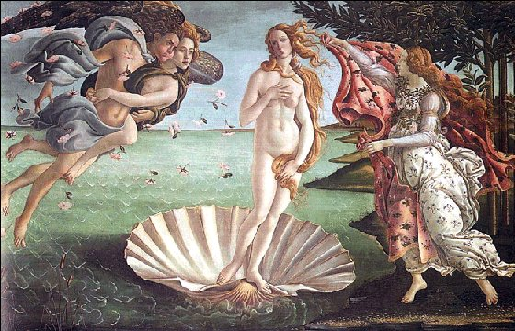
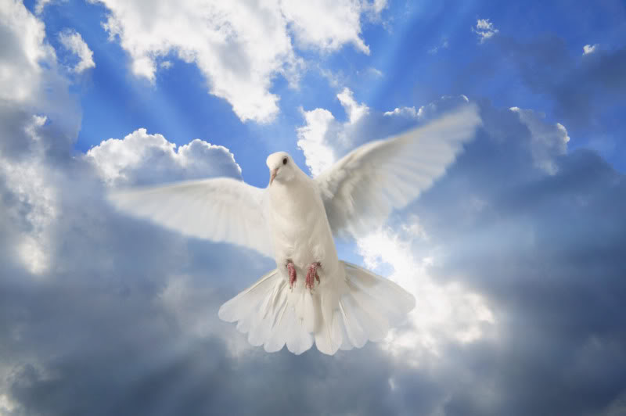
Aphrodite/Venus
Goddess of love and beauty
Symbol: Dove

Slide 7

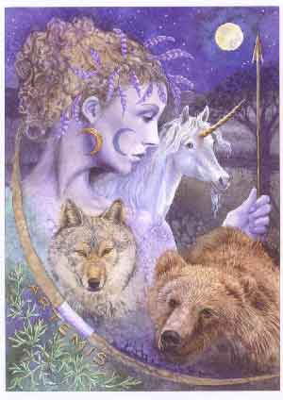
Artemis/Diana
Goddess of wilderness, the hunt, wild creatures and the moon
Symbols: Bow, Deer

Slide 8
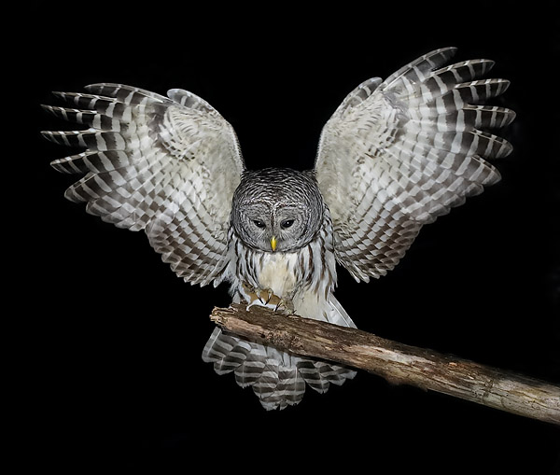
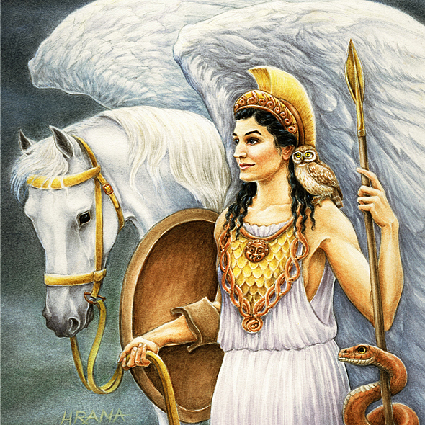
Athena/Minerva
Goddess of wisdom, military victory, civility and justice
Symbols: Owl, Shield, Olive Tree

Slide 9

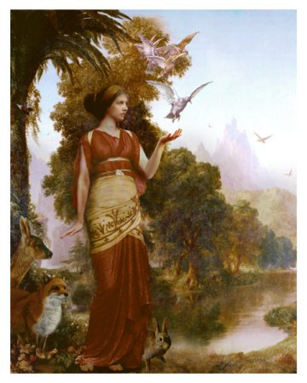
Demeter/Ceres
Goddess of the harvest, seasons and fertility
Mother of Persephone
Symbols: Sceptre, Corn

Slide 10

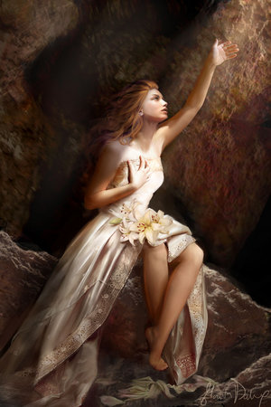
Persephone/Proserpine
Goddess of the Underworld
Married to Hades
Daughter of Demeter
Associations with Pomegranate seeds

Slide 11
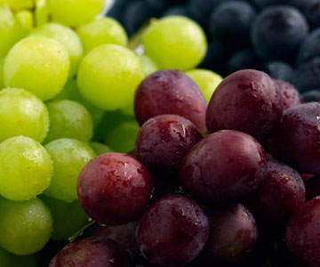
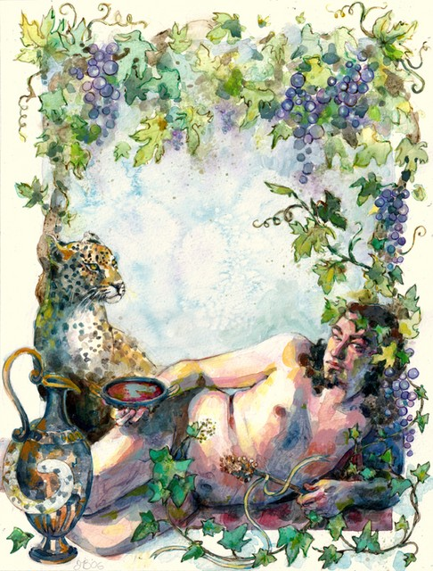

Dionysus/Bacchus
God of wine
Symbols: Grapes

Slide 12

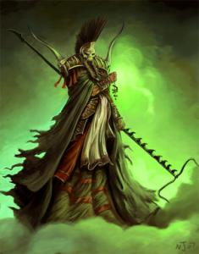
Hades/Pluto
God of the Underworld

Slide 13
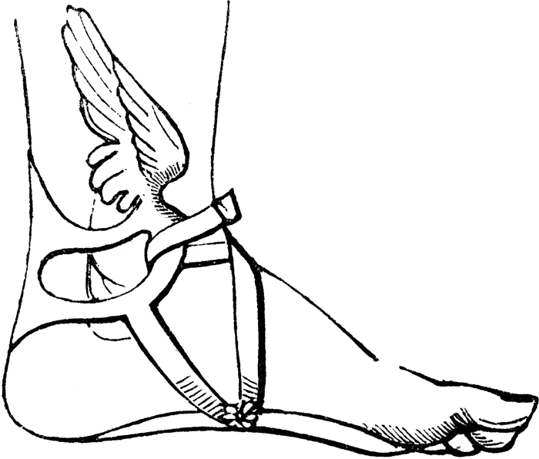
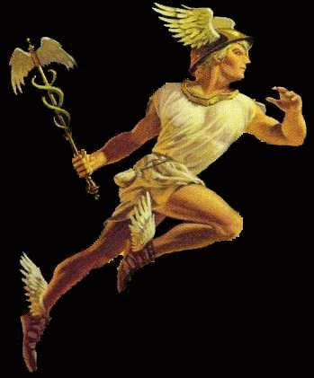
Hermes/Mercury
Messenger of the gods
Winged boots

Slide 14
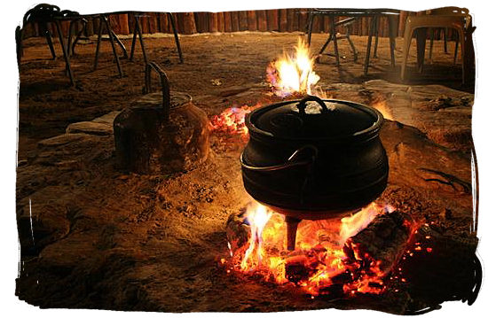
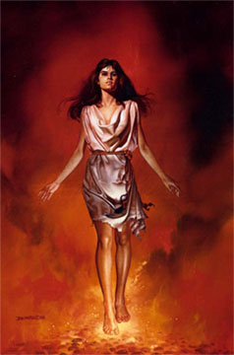
Hestia/Vesta
Goddess of the hearth and home

Slide 15
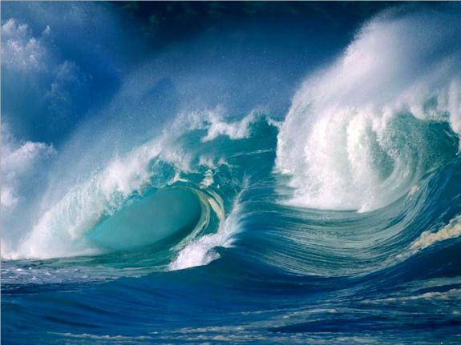
Poseidon/Neptune
God of the sea
Trident

Slide 16
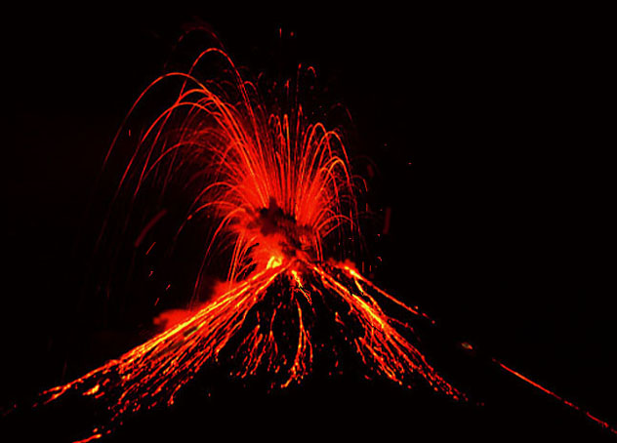
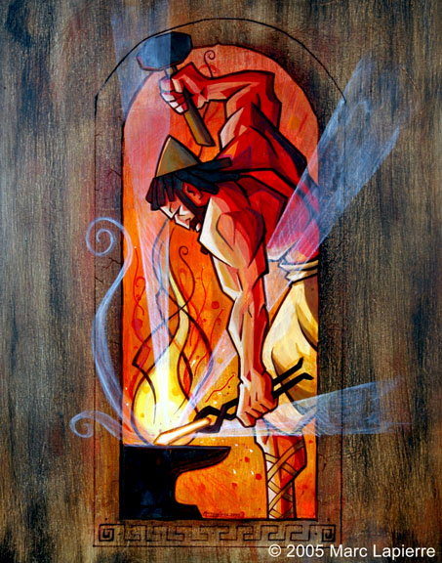
Hephaestus/Vulcan
God of the forge, fire and volcanoes

Slide 17
Allusion
An ALLUSION is a reference to an outside work.
For example, when a character on a TV show exclaims, “You astound me, Holmes!”, it is an allusion to The Adventures of Sherlock Holmes.
On a less literary level, if you stub your toe and yell, “D’oh!”, you’re making an allusion to The Simpsons.
An allusion can be made to a book, a song, or a poem. Even visual allusions can be made to art or film. Movies that are parodies are filled with allusions. For them to be true parodies, they have to imitate (through allusion) the movies they are spoofing. It’s really much more complicated to explain than do.

