Slide 1
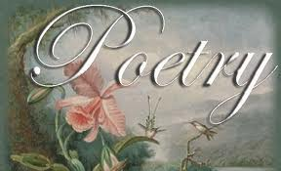
Terms

Slide 2
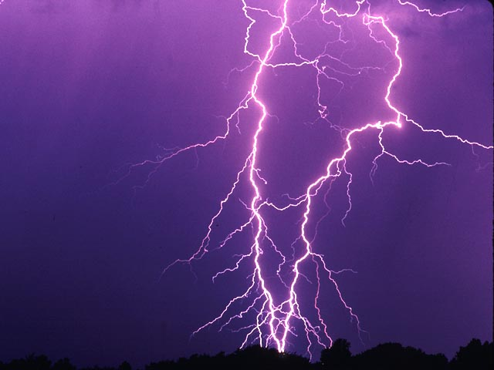
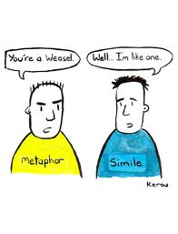
SIMILES are not METAPHORS
METAPHORS are not SIMILES
For instance, a simile that compares a person with a bullet would go as follows: "Chris was a record-setting runner as fast as a speeding bullet." A metaphor might read something like, "When Chris ran, he was a speeding bullet racing along the track."

Slide 3
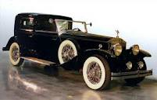
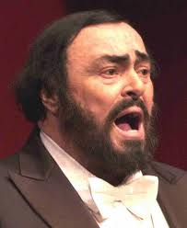
A metaphor expresses the unfamiliar (the tenor) in terms of the familiar (the vehicle).
When Neil Young sings, "Love is a rose,"
Rose = the vehicle
Love = the tenor

Slide 4
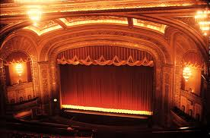
The world is a stage.
All the world's a stage, And all the men and women merely players; They have their exits and their entrances, And one man in his time plays many parts

Slide 5
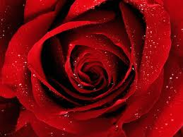
"Love Is A Rose“ Love is a rose but you better not pick it It only grows when it's on the vine. A handful of thorns and you'll know you've missed it You lose your love when you say the word "mine."

Slide 6
Simile
An indirect comparison using “like” or “as.”
When we describe something, we often use the expression, "It was like" so that we can convey our experience vividly to our listener who may never have seen or heard what we are describing. We want our listener to understand fully what we have seen, heard or felt.

Slide 7
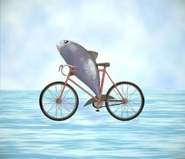
“A woman without a man is like a fish without a bicycle.”
- Irina Dunn

Slide 8
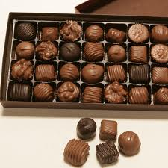
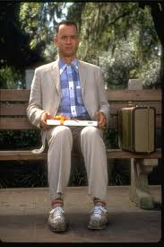
“Life is like a box of chocolates…”

Slide 9
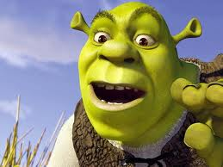
Ogres
are
like
onions

Slide 10
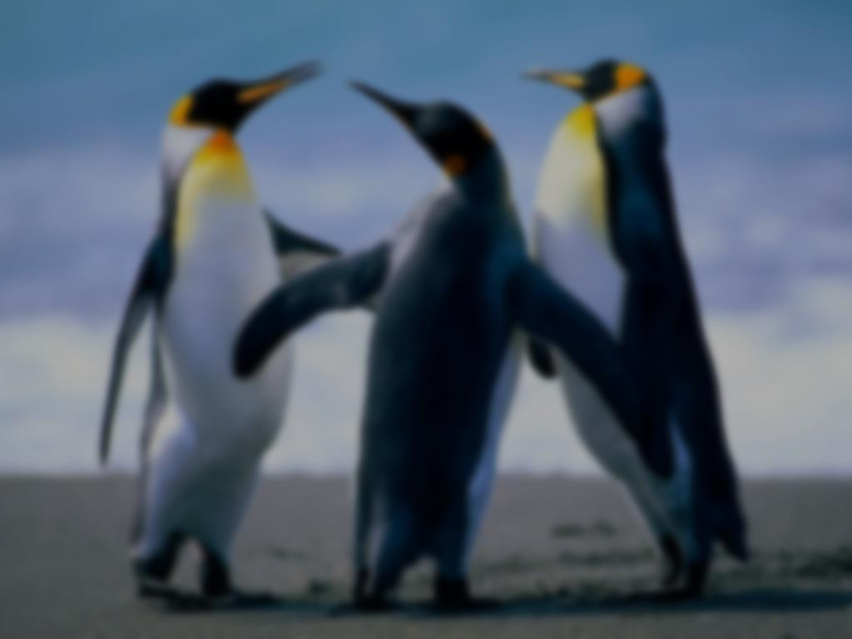
Hyperbole
A hyperbole is an outrageous exaggeration that emphasizes a point, and can be ridiculous or funny. Hyperboles can be added to fiction to add color and depth to a character.
Examples are:
You snore louder than a freight train.
She is so dumb, she thinks Taco Bell is a Mexican phone company.
I had to walk 15 miles to school in the snow, uphill.
You could have knocked me over with a feather.

Slide 11
Personification
A figure of speech in which an inanimate object or abstraction is given human qualities or abilities.
When you make a thing, idea, or an animal do something only humans can do.

Slide 12
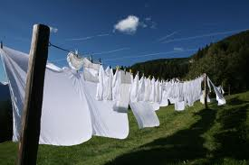
The wind loves to DANCE with the clothes on the line.

Slide 13
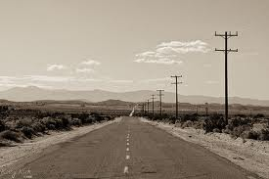
“A long time ago, me and my brother Kyle here, we was hitchhiking down a long and lonesome road.” The road was lonesome. http://www.youtube.com/watch?v=_lK4cX5xGiQ&ob=av3e

Slide 14
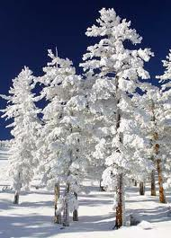
Fear knocked on the door. Faith answered. There was no one there. - Proverb
Snow speaks to the people, its falling above in the glooming sunlight. Its white sparkling voice echoes as it falls through the air - Jake
The operation is over. On the table, the knife lies spent, on its side, the bloody meal smear-dried upon its flanks. The knife rests. - Richard Selzer, "The Knife"
The only monster here is the gambling monster that has enslaved your mother! I call him Gamblor, and it's time to snatch your mother from his neon claws! - Homer Simpson, “The Simpsons”

Slide 15
Alliteration:
Is the repetition of initial sounds in the beginning of neighboring words.
Examples: sweet smell of success, a dime a dozen, bigger and better, jump for joy

Slide 16
Consonance is the repetition of consonant sounds, but not vowels. Example: Some mammals are clammy the string was strong the lumpy bumpy road

Slide 17
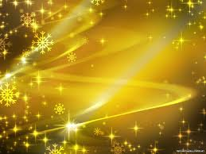
Assonance The use of similar vowel sounds within a word. Example: fleet feet sweep by sleeping geeks.

Slide 18
More terms…
Rhyme Scheme is the ordered pattern of rhymes at the ends of the lines of a poem or verse.
A quatrain is a type of stanza consisting of four lines.
A couplet is two lines of verse, usually in the same meter and joined by rhyme, that form a unit.

Slide 19
A sonnet is a poem consisting of three quatrains and a couplet , written in iambic pentameter.

